Slide 1
Monitoring of Azure Docker and its applications

Slide 2
Structure of our Azure Docker
Master Node : Linux – k8s-master-6478F9E2-0
Agent Node : Windows – 6478Facs9000
Application : Expense App
Monitoring using OMS (Operational Management Suite)
Disadvantage of OMS on Docker Monitoring
No metrics are available for Applications

Slide 3
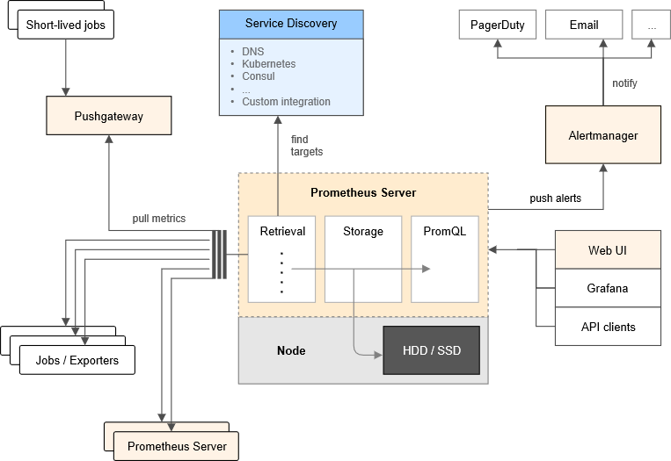
Monitoring using Prometheus
Prometheus supports application metrics through Client libraries like Nuget packages “Prometheus Web” for application code
stores time series data
Supports exporters like HAProxy, StatsD, Graphite, for extra metrics.
Supports alertmanager to handle alerts
Provides UI tools like Grafana ( Grafana takes Prometheus as data source)

Slide 4
Azure Container Monitoring using Grafana
Grafana takes Azure Monitor and Application Insights as Data Source
Demo for Creation of Grafana in Azure and its Datasource configuration
Azure Monitor API Details
Subscription Id | In the Azure Portal, navigate to Subscriptions -> Choose subscription -> Overview -> Subscription ID
Tenant Id | In the Azure Portal, navigate to Azure Active Directory -> Properties -> Directory ID.
Client Id | In the Azure Portal, navigate to Azure Active Directory -> App Registrations -> Choose your app -> Application ID.
Client Secret | To create a new key, log in to Azure Portal, navigate to Azure Active Directory -> App Registrations -> Choose your app -> Keys.
Application Insights Details
API Key | In Azure portal, Application Insights ->Expense App -> Settings -> API Access -> Create API Key -> Generate Key
Application ID | In Azure Portal -> Expense App -> Settings -> API Access -> Application ID
Assign Role to App | Subscription -> Subscription Name -> Access Control -> Add -> Role as Reader -> Select as App Name(Expense App)

Slide 5
Red and Use Method of Monitoring
With the RED method, three key metrics for monitoring:
(Request) Rate – the number of requests, per second, your services are serving.
(Request) Errors – the number of failed requests per second.
(Request) Duration – The amount of time each request takes expressed as a time interval.
The USE method focuses more on monitoring performance to identify the root cause of performance issues and bottlenecks.

Slide 6
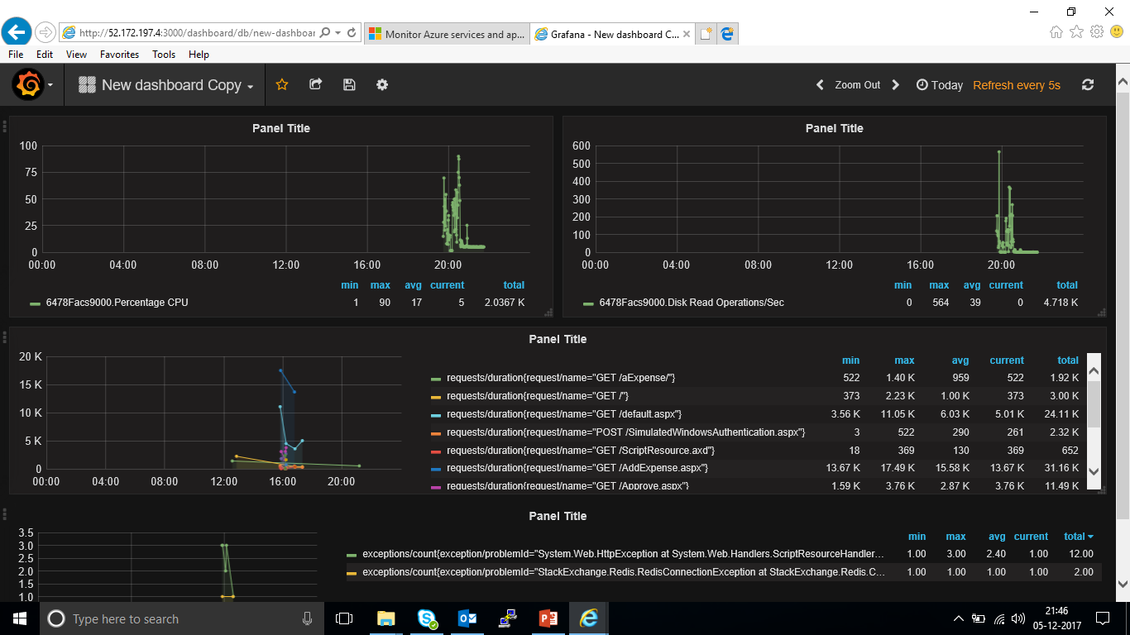
Grafana Dashboard

Slide 7
Metrics for Applications
Requests/Count Requests/Duration Requests/Failure PageViews/Count PageViews/Duration browserTimings/networkduration browserTimings/sendduration browserTimings/receiveduration browserTimings/processingduration browserTimings/total duration Users/Count Users/Authenticated Sessions/Count CustomEvents/Count Dependencies/Count Dependencies/Failed Dependencies/Durations Exceptions/Count Exceptions/browser Exceptions/Server availabilityResults/count availabilityResults/availabilityduration Traces/count performanceCounters/RequestExecutiontime performanceCounters/RequestPerSecond performanceCounters/RequestInQueue performanceCounters/RequestInQueue performanceCounters/MemoryAvailableBytes performanceCounters/RequestInQueue performanceCounters/ExceptionsPersecond performanceCounters/ProcessCpuPercentage performanceCounters/ProcessCpuPercentageTotal performanceCounters/ProcessorCpuPercentage performanceCounters/ProcessIOBytesPerSecond performanceCounters/ProcessPrivateBytes
Metrics for Azure Monitor
PercentageCPU Network In Network Out Disk Read Bytes Disk Write bytes Disk Read Operations/ Second Disk Write Operations/ Second CPU Credits Remaining CPU Credits Consumed

Slide 8
Thank You

